Slide 1
Log Analysis and Debugging
Log management | ELK Stack | Loki | Performance bottlenecks | Debugging

Slide 2
Introduction
• Logs provide insight into system behavior and performance.
• Log analysis is critical for identifying issues, bottlenecks, and tracking errors.
• Debugging uses logs to trace and resolve problems efficiently.

Slide 3
What is Log Management?
• Collecting, storing, analyzing, and visualizing log data.
• Includes centralized logging, filtering, real-time monitoring, and alerting.

Slide 4
Common Log Sources
• Application logs
• System logs (/var/log/ on Linux)
• Web server logs (Apache, Nginx)
• Database logs
• Cloud infrastructure logs (e.g., AWS CloudWatch)

Slide 5
The ELK Stack
• Elasticsearch: Stores and indexes log data
• Logstash: Collects, parses, transforms logs
• Kibana: Visualizes data from Elasticsearch
• Real-time analysis and dashboard creation

Slide 6
Architecture of ELK Stack
Beats/Fluentd → Logstash → Elasticsearch → Kibana
Example: Logstash parses Nginx logs → Elasticsearch indexes data → Kibana shows request heatmap

Slide 7
Introduction to Loki
• Developed by Grafana Labs
• Aggregates logs in a cloud-native way
• Integrates with Prometheus and Grafana
• Stores logs as streams, not indexed entries

Slide 8
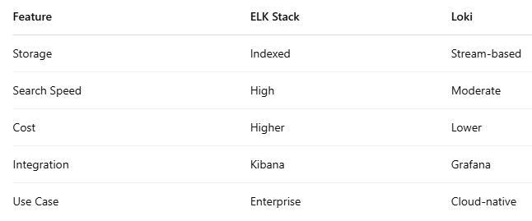
Loki vs ELK

Slide 9
Identifying Performance Bottlenecks
• Monitor CPU, memory, disk, and network logs
• Detect slow response times or failed requests
• Correlate logs and metrics using tools like ELK, Loki, Prometheus

Slide 10
Debugging with Logs
• Look for error patterns, stack traces, warnings
• Use timestamps to reconstruct event sequences
• Filter by user ID, session ID, or request path

Slide 11
Best Practices
• Centralize logs from all environments
• Use structured logging (JSON)
• Set retention policies
• Enable alerting and monitoring
• Avoid excessive logging

Slide 12
Summary
• Logs are essential for monitoring and debugging
• ELK and Loki provide powerful log analysis tools
• Performance bottlenecks can be identified through logs
• A systematic approach improves debugging efficiency

